Slide 1
Influence of Dipole-Dipole Interaction on Electron Dynamics in Cold Rydberg Gas
Tao Zhou

Slide 2
Defense Outline
Rydberg Atoms and Dipole-Dipole Interactions
Decay in Cold Rydberg Atoms
Wavepackets Evolution and DD Interaction
Coherence Transfer through DD Interaction
Conclusion and Prospect

Slide 3
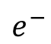
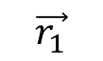
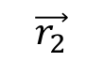
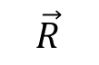
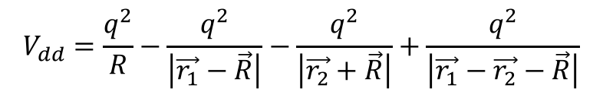
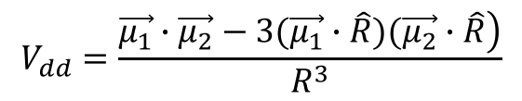
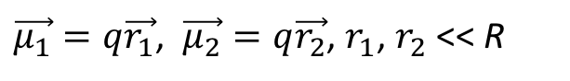
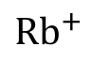
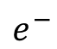
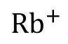
Rydberg Atoms and Dipole-Dipole Interaction Rydberg Atom and DD interaction
[*]
$$\vec{r_{1}}$$
$$e^{−}$$
$$\vec{R}$$
$${Rb}^{+}$$
$$\vec{r_{2}}$$
$${Rb}^{+}$$
$$e^{−}$$
$$V_{dd}=\frac{q^{2}}{R}−\frac{q^{2}}{\left|\vec{r_{1}}−\vec{R}\right|}−\frac{q^{2}}{\left|\vec{r_{2}}+\vec{R}\right|}+\frac{q^{2}}{\left|\vec{r_{1}}−\vec{r_{2}}−\vec{R}\right|}$$
$$V_{dd}=\frac{\left.\vec{μ_{1}}∙\vec{μ_{2}}−3(\vec{μ_{1}}∙\hat{R})(\vec{μ_{2}}∙\hat{R}\right)}{R^{3}}$$
$\vec{μ_{1}}=q\vec{r_{1}}$, $\vec{μ_{2}}=q\vec{r_{2}}$, $r_{1}$, $r_{2}$ << R
[*]:Thomas F. Gallagher. Rydberg Atoms. Cambridge University Press 1994.
Notes:
At first let me introduce some background. My research target is Rydberg atoms. So what are Rydberg atoms. Here is a semiclassic picture of a Rydberg atom. It has one electron which has a very high principal number. So this electron is having a very orbit. It has other properties brought be the high orbit feature. And the most interesting thing is that, from this picture, we can see the electron spends most of its orbit time far from the core. So we can simplify this picture to a classic dipole picture like this. And the dipole defination is u equals q r, direction is the direction from the positive charge to the negative charge.

Slide 4
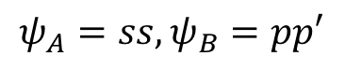
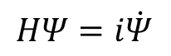
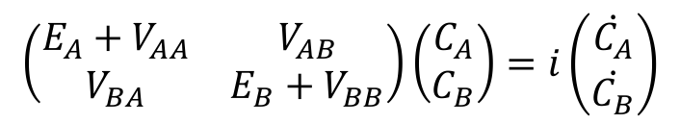
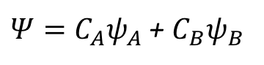
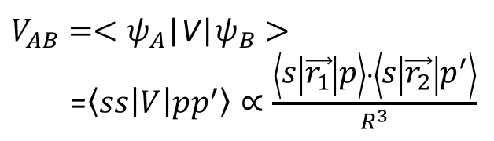
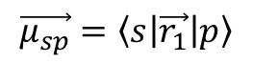
Rydberg Atoms and Dipole-Dipole Interaction DD Interaction Destroys Degeneracy
$$ψ_{A}=ss, ψ_{B}=pp′$$
$$HΨ=i\dot{Ψ}$$
ss
pp’
$Ψ=C_{A}ψ_{A}$ + $C_{B}ψ_{B}$
$$\left(\begin{matrix}E_{A}+V_{AA} & V_{AB} \\ V_{BA} & E_{B}+V_{BB}\end{matrix}\right)\left(\begin{matrix}C_{A} \\ C_{B}\end{matrix}\right)=i\left(\begin{matrix}\dot{C_{A}} \\ \dot{C_{B}}\end{matrix}\right)$$
Pair Energy
pp’
ss
$V_{AB}=<ψ_{A}$|V|$ψ_{B}>$
=$\left\langle ss | V | pp^{′}\right\rangle ∝\frac{\left\langle s | \vec{r_{1}} | p\right\rangle ∙\left\langle s | \vec{r_{2}} | p^{′}\right\rangle }{R^{3}}$
Field
$$\vec{μ_{sp}}=\left\langle s | \vec{r_{1}} | p\right\rangle$$
transit dipole moment
Thomas F. Gallagher. Rydberg Atoms. Cambridge University Press 1994.
Notes:
At first let me introduce some background. My research target is Rydberg atoms. So what are Rydberg atoms. Here is a semiclassic picture of a Rydberg atom. It has one electron which has a very high principal number. So this electron is having a very orbit. It has other properties brought be the high orbit feature. And the most interesting thing is that, from this picture, we can see the electron spends most of its orbit time far from the core. So we can simplify this picture to a classic dipole picture like this. And the dipole defination is u equals q r, direction is the direction from the positive charge to the negative charge.

Slide 5
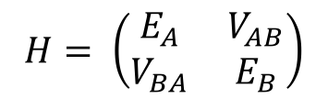
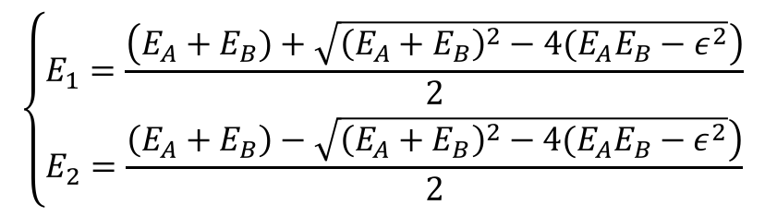
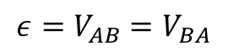
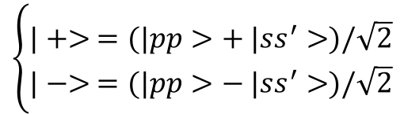
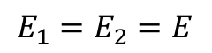
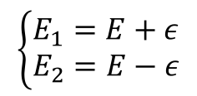
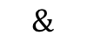
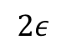
Rydberg Atoms and Dipole-Dipole Interaction DD Interaction Destroys Degeneracy
$$H= \left(\begin{matrix}E_{A} & V_{AB} \\ V_{BA} & E_{B}\end{matrix}\right)$$
$$\left\{\begin{matrix}E_{1}=\frac{\left(E_{A}+E_{B})+\sqrt{{\left(E_{A}+E_{B}\right)}^{2}−4(E_{A}E_{B}−ε^{2}}\right)}{2} \\ E_{2}=\frac{\left.\left(E_{A}+E_{B}\right)−\sqrt{{\left(E_{A}+E_{B}\right)}^{2}−4(E_{A}E_{B}−ε^{2}}\right)}{2}\end{matrix}\right.$$
ss
pp’
Pair Energy
$$2ε$$
$$ε=V_{AB}=V_{BA}$$
pp’
ss
$$E_{1}=E_{2}=E$$
$$\left\{\begin{matrix}E_{1}=E+ε \\ E_{2}=E−ε\end{matrix}\right.$$
$$\left\{\begin{matrix}|+> =(|pp>+ |ss^{′}>)/\sqrt{2} \\ |−> =(|pp>− |ss^{′}>)/\sqrt{2}\end{matrix}\right.$$
$$\&$$
Field
Notes:
Lets’ continue this example. Now consider a resonant process in which pp and ss’ have exactly the same energy. So that E1=E2. Then from this matrix, we can get new eigen energies E plus = E + M and E minus = E – M and new eigen states plus and minus. If we draw the effect out, we can see the degenerate energy states have been split into two states with different energies.

Slide 6
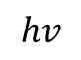
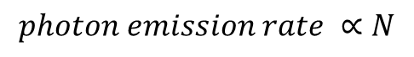
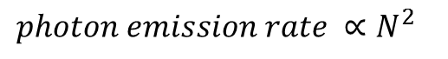
Decay in Cold Rydberg Atoms Superradiance Emission
spontaneous emission
superradiance emission
high P
λ
$$hv$$
d
low S
$photon emission rate ∝N^{2}$
$$photon emission rate ∝N$$
R.H. Dicke, Physics Review. 93, 99 (1954)
M. Gross, P. Goy, C. Fabre, S. Haroche, and J. M. Raimond, Phys. Rev. Lett. 43, 343 (1979)
Notes:
Suppose I have a two level system and one atom starts on the high level. In one unit time delta t, the atom can decay from high state to the low state and emit one photon, which has an energy of hv. This is a very normal decay for one individual atoms and the radiance rate is roughly 1/delta t. Now if I have a cloud, composed of N atoms, and all of them are in the high state at first. We would expect the atoms to jump from the high state to the low state and emit N photos in delta t. The radiance speed for this system is proportional to N. But if the diameter of this cloud is much smaller than the wavelength of the photons and some other critical criteria have been satisfied, this emission speed would be accelerated and this radiance speed would be proportional to N square. Such a process is called Superradiance. And Superradiance is what I mean for “collective decay”. If our eyes can see the photons from this cloud, we would see that this cloud flashes in a short time and then dies quickly.
Superradiance is observed in many systems but was not observed in the cold Rydberg atoms until 2007. One paper developed one medal of the criteria of superradiance and used superradiance to explain the experiment result in the paper.

Slide 7
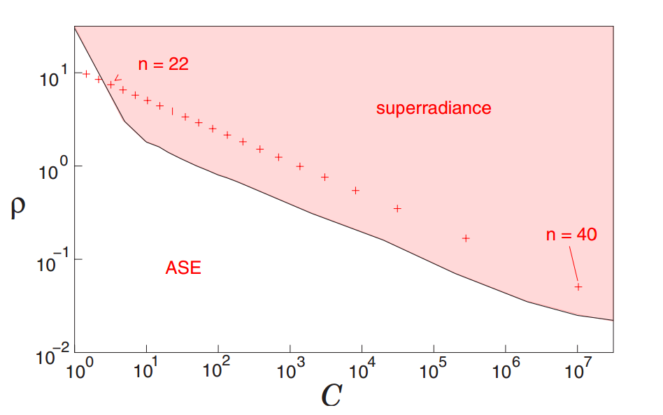
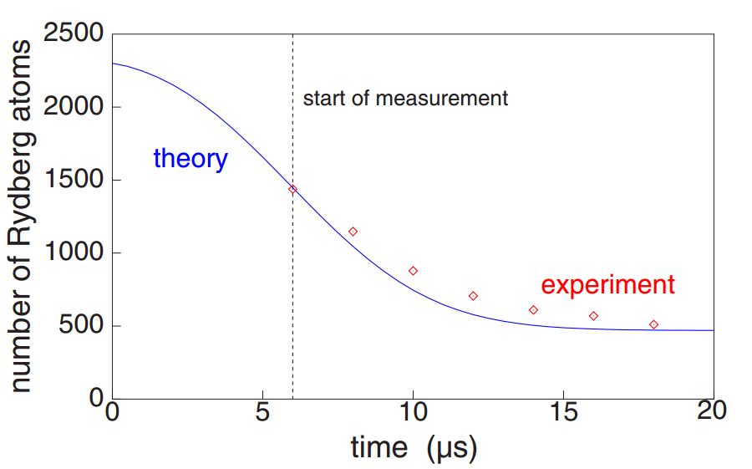
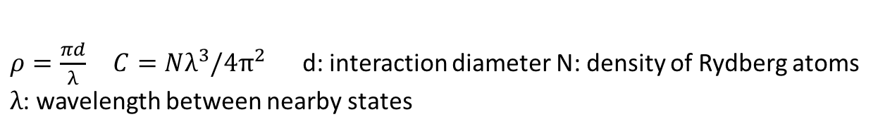
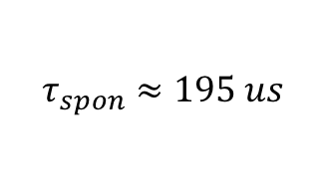
Decay in Cold Rydberg Atoms Superradiance in Cold Rydberg Atoms?
Condition?
Ionization signal for atoms starting from 43P
[*]
n = 26
n = 32
$$τ_{spon}≈195 us$$
n = 40
$ρ=\frac{πd}{λ} C=Nλ^{3}/4π^{2}$ d: interaction diameter N: density of Rydberg atoms
$λ$: wavelength between nearby states
[*] T. Wang, S.F. Yelin, R. Cote, and etc. Physics Review A 75, 033802(2007)
also see J. O. Day, E. Brekke, and T. G. Walker. Physics Review A 77, 052712(2008)
Notes:
The model’s mathematic form is very sophisticated. Fortunately, the paper provided two parameters to help us to determine whether Superradiance would happen in cold Rydberg atoms. The two parameters are rho and c.
From the first plot, we see for Rydberg states from 22 to 40, if rho and C are locating in the red area, Superradiance should happen. The second plot is the ionization signal for atoms starting from 43P. The number of Rydberg atoms means atoms with Rydberg states higher than 27, not only atoms on state 43P. In our lab, we can produce cold Rydberg atoms. We also have selective ionization field, so we can see the population on 40P directly. We want to repeat this superradiance experiment.
In the following experiment, we tested stated of 26, 32 and 40.

Slide 8
Decay in Cold Rydberg Atoms Experiment Procedure
40s
Signal
MCP
5p
Cold atoms
_
L
5s
SSFI
+
d
T
Laser beam
Notes:
The process is pretty simple and straightforward. The following is the setup and experiment process.
First, we generate a cloud of cold atoms using Magneto Optical Trap. The atoms we use are Rubidium 85.
2nd, we use a laser beam to transfer the cold atoms to Rydberg states. The focal point of the laser beam is almost inside the atom cloud and produced a cigar shaped interaction area. In the interaction area, atoms will be excited to ns or np state from 5p. To generated np states, we also need to apply a weak field.
Then the Rydberg atoms have been left to emit photons and decay themselves. After time T, a selective ionization field has been applied to the atoms and ionize the atoms at different Rydberg state. The ionization signal shows how many atoms are on each Rydberg states.

Slide 9
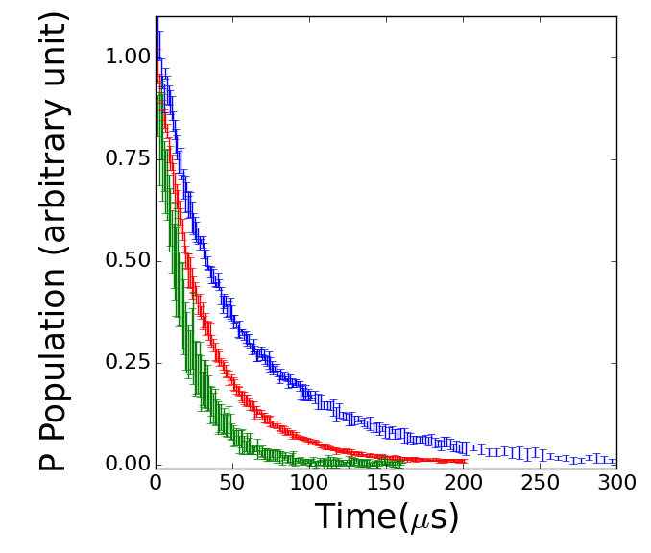
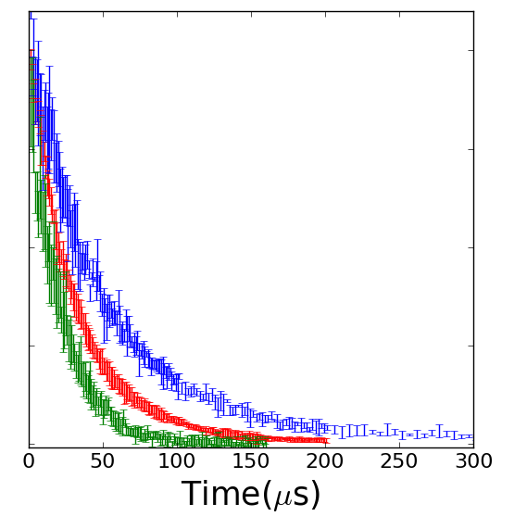
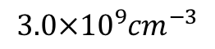
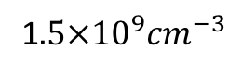
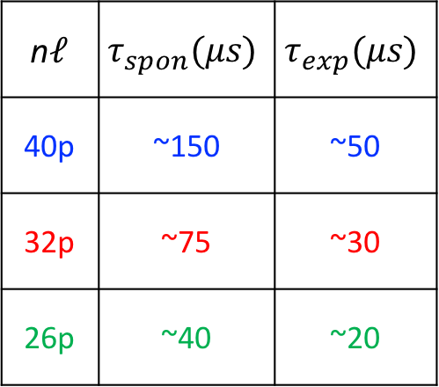
Decay in Cold Rydberg Atoms Experiment Result
$$3.0×{10}^{9}{cm}^{−3}$$
1$.5×{10}^{9}{cm}^{−3}$
n$ℓ$ | $$τ_{spon}(μs)$$ | $$τ_{exp}(μs)$$
40p | ~150 | ~50
32p | ~75 | ~30
26p | ~40 | ~20
Notes:
To explore more, first, I tested other P states at low density. I tested 32P and 26P. And this is the result. Blue is 40P, red is 32p and green line is 26P. We see p population is decaying, but the decay time is still larger than a few us, which means there is no Superradiance.
Then how about increasing the density? The largest density our lab can get is about 3 time 10 to the 9th order per cm cube. Now if the atoms get that density, I got this plot.
There is basically no difference from the low density case.
Now what if the staring Rydberg states are S states?

Slide 10
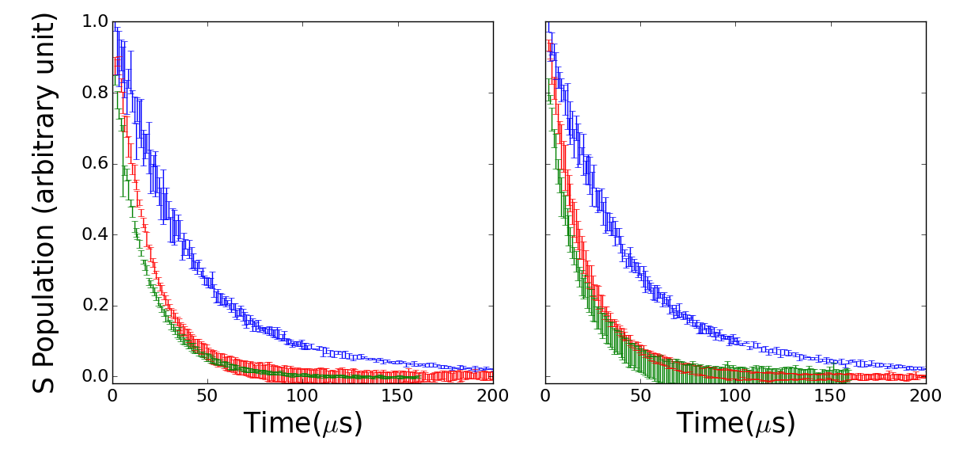
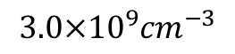
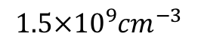
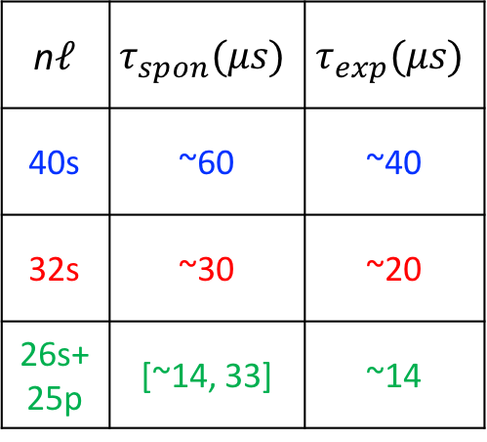
Decay in Cold Rydberg Atoms Experiment Result
$$3.0×{10}^{9}{cm}^{−3}$$
$$1.5×{10}^{9}{cm}^{−3}$$
n$ℓ$ | $$τ_{spon}(μs)$$ | $$τ_{exp}(μs)$$
40s | ~60 | ~40
32s | ~30 | ~20
26s+25p | [~14, 33] | ~14
Notes:
For Rydberg atoms starting from s states, we found that decay time of s states are still larger than a few seconds, and changing density does not change the decay time. There is basically no difference from the result on P state.

Slide 11
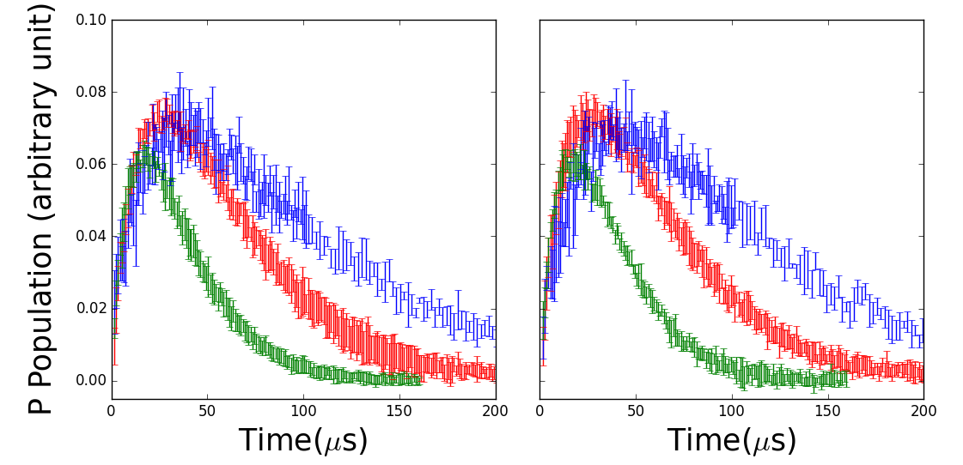
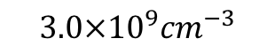

Decay in Cold Rydberg Atoms Experiment Result
$$3.0×{10}^{9}{cm}^{−3}$$
$$1.5×{10}^{9}{cm}^{−3}$$
np
I: n = 40
I: n = 32
I: n = 26
ns
(n-1)p
Notes:
But due to black body radiation, which comes from external environment, atoms from s states could be transferred to higher p and low p states. Due to the limitation of our system, we could not detect the lower p states. The two plots are the population of higher P states. We see that the population is first increasing, due to black body radiation. Then the population decreases, because of spontaneous decay. The decay time is still larger than a few us.

Slide 12
Decay in Cold Rydberg Atoms Model Considering Blackbody Radiation and Spontaneous Decay
41S
39D
B
S
B
40P
S
B
B
40S
S
B
38D
B
S
39P
S
B
S
B
39S
37D
S
S
Notes:
Knowing the blackbody radiation, we can combine the spontaneous radiation and blackbody radiation and build such a simplified model. The red dash line between two states means there is blackbody stimulated transition between these two states. The blue dash wiggles mean the spontaneous decay from one state to many other states. This plot is using the atoms starting from Rydberg state 40S as an example. For other starting states, they each use a very similar model.

Slide 13
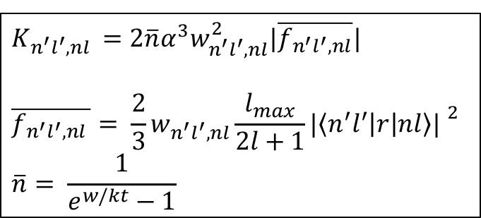
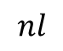
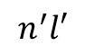
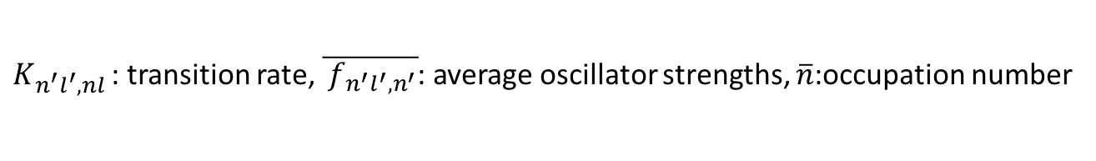
Decay in Cold Rydberg Atoms Calculation
Blackbody radiation induced transition rate
$$n^{′}l′$$
[*]
$$K_{n^{′}l^{′},nl }=2\overline{n}α^{3}w_{n^{′}l^{′},nl}^{2}|\overline{f_{n^{′}l^{′},nl}}|$$
$$\overline{f_{n^{′}l^{′},nl }}= \frac{2}{3}w_{n^{′}l^{′}, nl}\frac{l_{max}}{2l+1}{|\left\langle n^{′}l^{′} | r | nl\right\rangle | }^{2}$$
$$\overline{n}= \frac{1}{e^{w/kt}−1}$$
$$nl$$
$K_{n^{′}l^{′},nl }$: transition rate, $\overline{{ f}_{n^{′}l^{′},n^{′}}}$: average oscillator strengths, $\overline{n}$:occupation number
[*] Thomas F. Gallagher, Rydberg Atoms, Cambridge University Press 1994.

Slide 14
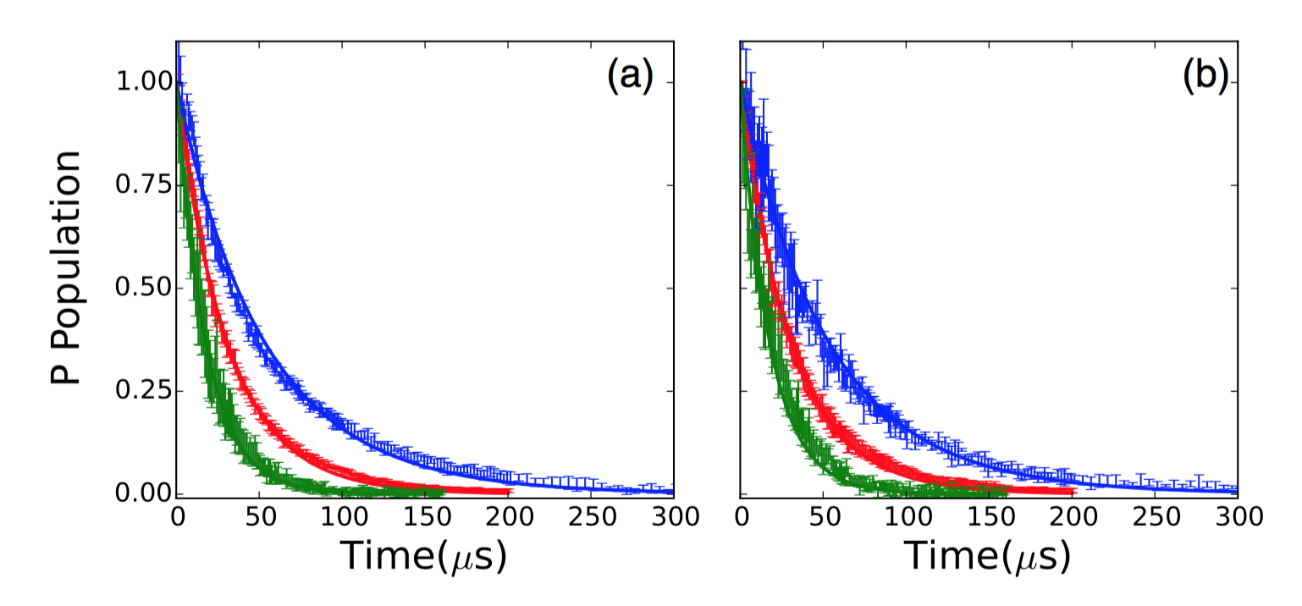
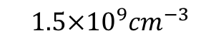

Decay in Cold Rydberg Atoms Rate Equation Calculation Result
Results for P states
$$3.0×{10}^{9}{cm}^{−3}$$
$$1.5×{10}^{9}{cm}^{−3}$$
I: n = 40
I: n = 32
I: n = 26

Slide 15
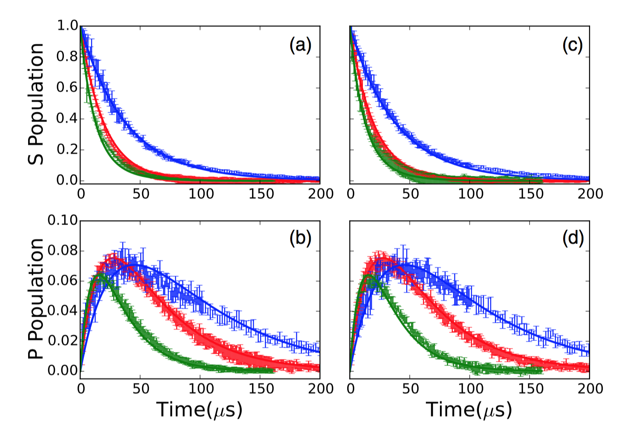
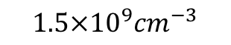

Decay in Cold Rydberg Atoms Rate Equation Calculation Result
Results for S states
$$3.0×{10}^{9}{cm}^{−3}$$
$$1.5×{10}^{9}{cm}^{−3}$$
I: n = 40
I: n = 32
I: n = 26*

Slide 16


Decay in Cold Rydberg Atoms Analysis and Discussion
$$|2>$$
$$|1>$$

Slide 17
Decay in Cold Rydberg Atoms Analysis and Discussion
$$|2>$$
$$|1>$$

Slide 18

Decay in Cold Rydberg Atoms Analysis and Discussion
Inhomogeneities caused by different factors
Factor
 | DD interaction (MHz) | Electric field (MHz) | Magnetic field (MHz)
40s | 17 | 12 | ~1
32s | 6.2 | 2.2 | ~1
26s | 2.4 | 0.43 | ~1
40p | 20 | 30 | ~1
32p | 7.8 | 13 | ~1
26p | 3.1 | 4.9 | ~1
State n$ℓ$

Slide 19
Decay in Cold Rydberg Atoms Conclusion
Found no evidence for collective decay (superradiance)
Calculation only considers spontaneous decay and blackbody radiation fits the measurement
Suppression could be caused by inhomogeneities brought by DD interaction, electric field gradient and magnetic field gradient
Unified DD interaction may enable superadiance

Slide 20

Wavepackets evolution and DD Interaction Experiment
32p
32s
31p
T
$$∆T$$
5p
THz 1
THz 2
Time Line

Slide 21

Wavepackets evolution and DD Interaction THz radiations
Create wavepackets (pump) | & | Probe wavepacket phase (probe)
$$E_{n}−E_{n−1}∝ \frac{1}{n^{3}}$$ 32s to 32p about 0.13 THz |  | $$φ=C_{p}|p>+C_{s}|s>e^{−i∆Et}$$ $$H^{′}=q\vec{E}∙\vec{r}$$ $$i{\dot{C}}_{p}=e^{i∆Et^{′}}<p\left|H^{′}\right|s>C_{s}e^{i∆ET}$$ ${\dot{C}}_{p}\sim sin⁡(∆ET$)
Optical Ramsey Interferometer [*]
[*] R.R. Jones and L. D. Noordam, etc, Advance in Atomic, Molecular, and Optical Physics, vol 38, Academic Press, 1998
Notes:
But SSFI can only detect the population of each state. It has to be combined with other setup to be useful in our experiment. We use THz pulses in our lab. There are two main reasons to use THz. First, for higher Rydberg atoms, the energy gap between adjust states is roughly of the THz order. For example…. So the Thz pulse can redistribute population of Rydberg atoms on states. The second reason is that it could be used as a wavepacket phase probe. If we shoot a THz pulse at the atoms, it could be viewed as a pertubation. From this we can see the pertubation depends on the phase of the wavepacket.

Slide 22




Wavepackets evolution and DD Interaction THz Pulses Generation
Tilted-Pulse-Front-Pumping (TPFP) optical rectification
Properties
[*]
grating
LiNb$O_{3}$
$$V_{THz}$$
fs,780nm, laser
$$V_{NIR}^{group}$$
[*] work done by Sha Li in our lab
Notes:
To generate THz pulses, we used the so called Tilted-Pulse-Front-Pumping (TPFP) optical rectification technology. Lisa was the first one in our lab to use this method to generate Thz pulse. I’ve stolen her setup and built my own THz generator. And this is the property of the THz pulse. The duration is a few femoto seconds and the frequency is sub THz, which is what I want.

Slide 23

Wavepackets evolution and DD Interaction Experiment Result
Density=0.3x${10}^{9} {cm}^{−3}$

Slide 24

Wavepackets evolution and DD Interaction Experiment Result
Density=2.1x${10}^{9} {cm}^{−3}$

Slide 25



Wavepackets evolution and DD Interaction Experiment Result
Density=0.3x${10}^{9} {cm}^{−3}$
Decay Ratio=
$I_{15ns}$/$I_{0ns}$=0.88
Density=2.1x${10}^{9} {cm}^{−3}$
$$\text{Decay} \text{Ratio}\text{=0.61 }$$

Slide 26


Wavepackets evolution and DD Interaction Experiment Result
Decay ratio at different densities
Density(${10}^{8}/{cm}^{3})$

Slide 27






Wavepackets evolution and DD Interaction Analysis
32s+32p↔32p+32s
ps
sp
|+>=|ps>+|sp>
2$ε$
|->=|ps>-|sp>
$$E_{0}$$
$$E_{0}+\text{2}ε$$
$$∆E+{\text{2}ε }_{1}$$
$$∆E+{\text{2}ε }_{2}$$
$$∆E+{\text{2}ε }_{3}$$
<ss|z|->=0
ss

Slide 28


Wavepackets evolution and DD Interaction Analysis
Two Pairs
Many Many Pairs
$$∆E_{1}$$
$$∆E_{1}$$
$$∆E_{2}$$
$∆E_{1}$…$∆E_{n}$

Slide 29


Wavepackets evolution and DD Interaction Simulation
Density = $2.2×{10}^{9} {cm}^{−3}$

Slide 30


Wavepackets evolution and DD Interaction Simulation Result
Simulation result for different densities
Density(${10}^{8}/{cm}^{3})$

Slide 31
Wavepackets evolution and DD Interaction Conclusion
Variation of DD interactions in the ensemble causes dephase of wavepacket coherence.
Future experiments includes well controlling the separation between atoms to extend the coherence time.

Slide 32




Coherence Transfer through DD Interaction Dipole Moment Oscillation
s: $Y_{0}^{0}=1/\sqrt{4π}$
p :${ Y}_{1}^{0}=\sqrt{3/4π}cosθ$
z
z
z
?
$φ=s+pe^{iΔEt}$:

Slide 33













Coherence Transfer through DD Interaction Coherence Transfer
$$φ\left(t\right)=\frac{1}{\sqrt{2}}(|s\text{⟩}|s^{′}\text{⟩}+|p\text{⟩}|s′\text{⟩}e^{iMt})$$
$$|+>$$
$$E=ε$$
$$ε$$
$$|ss^{′}>,|pp^{′}>$$
$$E=0$$
$$ε$$
$$φ\left(t\right)=\frac{1}{2}(|+\text{⟩}e^{−iε t}+|−\text{⟩}e^{iεt})+\frac{1}{\sqrt{2}}|p\text{⟩}|s′\text{⟩}e^{iDt}$$
$$|−>$$
$$E=−ε$$
$$φ\left(t\right)=\frac{cosε t}{\sqrt{2}} (\left|s\text{⟩}+cosεt|\text{p}\text{⟩}e^{iDt})\right|s^{′}\text{⟩}$$
$−i\frac{sinε t}{\sqrt{2}}\left|\text{p}\text{⟩}(\right|p^{′}\text{⟩}+isinεt|s^{′}\text{⟩}e^{iMt})$
$$|ps′>$$
$$E=−D$$

Slide 34

Coherence Transfer through DD Interaction Coherence Transfer
$$φ\left(t\right)=\frac{cosεt}{\sqrt{2}} (\left|s\text{⟩}+cosεt|p^{′}\text{⟩}e^{iDt})\right|s^{′}\text{⟩}−i\frac{sinεt}{\sqrt{2}}\left|\text{p}\text{⟩}(\right|p^{′}\text{⟩}+sinεt|s^{′}\text{⟩}e^{iDt})$$

Slide 35

Coherence Transfer through DD Interaction Coherence Transfer
$$φ\left(t\right)=\frac{cosεt}{\sqrt{2}} (\left|s\text{⟩}+cosεt|p^{′}\text{⟩}e^{iDt})\right|s^{′}\text{⟩}−i\frac{sinεt}{\sqrt{2}}\left|\text{p}\text{⟩}(\right|p^{′}\text{⟩}+sinεt|s^{′}\text{⟩}e^{iDt})$$

Slide 36

Coherence Transfer through DD Interaction Macroscopic Dephase in A Random Ensemble

Slide 37


Coherence Transfer through DD Interaction Experiment
33S
34P
SSFI
$$∆T$$

Slide 38




Coherence Transfer through DD Interaction Experiment Result
25s->24$p_{1/2}$
23s->34$p_{3/2}$
25s->24$p_{3/2}$
25s->25$p_{3/2}$

Slide 39



Coherence Transfer through DD Interaction Experiment Result
$∆T$=10 ns
$∆T$=600 ns
Wavenumber (${cm}^{−1})$

Slide 40



Coherence Transfer through DD Interaction Experiment Result
$∆T$=10 ns
$∆T$=600 ns
$∆θ$=${21}^{0}$

Slide 41


Coherence Transfer through DD Interaction Calculation Result
$∆T$ (ns)

Slide 42

Coherence Transfer through DD Interaction Analysis and Conclusion
THz pulse simulation uncertainties -- shape undetermined, amplitude undetermined.
The 2nd THz could not be perturbative, which could accelerate the decline of the phase difference.
Simulation does show a positive phase difference $<{90}^{o}$, which declines fast.
When well controlling the separation between atoms to extend the coherence time, further experiments include to observe the complete transfer of wavepacket motion, back and forth, between initial and induced wavepackets.

Slide 43
Conclusion and Prospect What I’ve Done
Explored the influence of Dipole-Dipole interaction and other effect on the collective lifetime of a cold gas.
Explored the influence of Dipole-Dipole interaction on wavepackets evolution.
Explored the coherence transfer from one atom to another through Dipole-Dipole interaction.

Slide 44
Conclusion and Prospect What could be done
Unify the distance between nearest neighbors in an ensemble and check the influence of Dipole-Dipole interaction again.
Explore the usage of coherence transfer through D-D interaction.
And more.

